Slide 1
Deutsches Zentrum für Luft- und Raumfahrt (DLR)
Königswinterer Straße 522-524
53227 Bonn
Selection Workshop and Proposal Presentation
ARESONUS :
Altus. Repetitio. Sonus. – Measuring of infrasound/aerosonic in the stratosphere
Presenting Team ARESONUS: Niclas Bierwisch, Sabine Köhler, Sven Malag

Slide 2
Agenda
Goals and purpose of ARESONUS
Scientific background
Team and organisation
Technical requirements and project design

Slide 3
1.Goals and motivation
Building a reference data bank
Creation of sound level-height model
Recognition signal, a.o. infrasound reference database
Secondary goal: possible proof of ELFI´s swinging
Stratosphere: natural reduction of higher frequencies

Slide 4
2. Scientific background 2.1 Sound in general
Sound
Mechanical waves
Physically: air pressure fluctuations
Frequency: number of oscillations per second → Hz
Sound level: height of air pressure fluctuations → dB

Slide 5
2. Scientific background 2.2 Infrasound
Infrasound
Frequenz < 20 Hz
Large wavelength
Attenuate less → travels further

Slide 6
2. Scientific background 2.3 Infrasound sources
natural
artifical
Geological activity
Waves
Thunderstorms
Traffic
Air turbines
Blastings

Slide 7
2. Scientific background 2.4 ELFI (Extremely Low Frequency and IMU)
Aim: evolve a system for non-stationary measurement of electromagnetic waves in low frequency
Goal: Measuring Schumann resonance 7 Hz
System: magnetic loop antenna
Problem: antenna swung in magnetic field of earth and generated strong induction voltages

Slide 8
2. Scientific background 2.4 ELFI (Extremely Low Frequency and IMU)
[Diagramm]

Slide 9
3. Team and organisation 3.1 The ARESONUS team
Member | Main purpose
Niclas Bierwisch | Management and Organisation
Sabine Köhler | Documentation
Sven Malag | Software Engineering
Ria Bele Pohley | Outreach
Johann Stiebritz | Testing and Hardware Engineering
Matthias Viehmann | Senior Scientist
Klaus-Peter Neitzke | Senior Scientist
Additionally every team member is included in designing and mechanical engineering tasks

Slide 10
3. Team and organisation 3.2 Outreach
Regular publishing at least once a Month
Social Media: X(former Twitter), Instagram, Facebook
University: contributing in Newsletter, creating webpage on universities website
Newspaper artikel

Slide 11
3.Team and organisation 3.3 Time schedule
Student Training week
→ Working design
February-May
Design optimization
May
Critical Design Review
→ Finished Design
May-September
Building reference data base (ISRD)
October
Esrange: Launch
End of 2024 till 2025
Evaluation and publication
January
December
Integration of system software

Slide 12
3.Team and organisation 3.4 Sponsoring
Mikrophone ISV1611-infra sponsored by ROGA Instruments

Slide 13
4.Technical requirements and project design 4.1 Technical requirements
Data rate 2.5 – 4 Mbyte/min
Total mass approximately 5 kg (+5-10 kg for lowering construction with self build microphone)
Power supply approximately 125 Wh
Sources of disturbance (external): Fans, pumps, motors, moving parts
Sources of disturbance (caused by us): Motor while lowering microphone

Slide 14
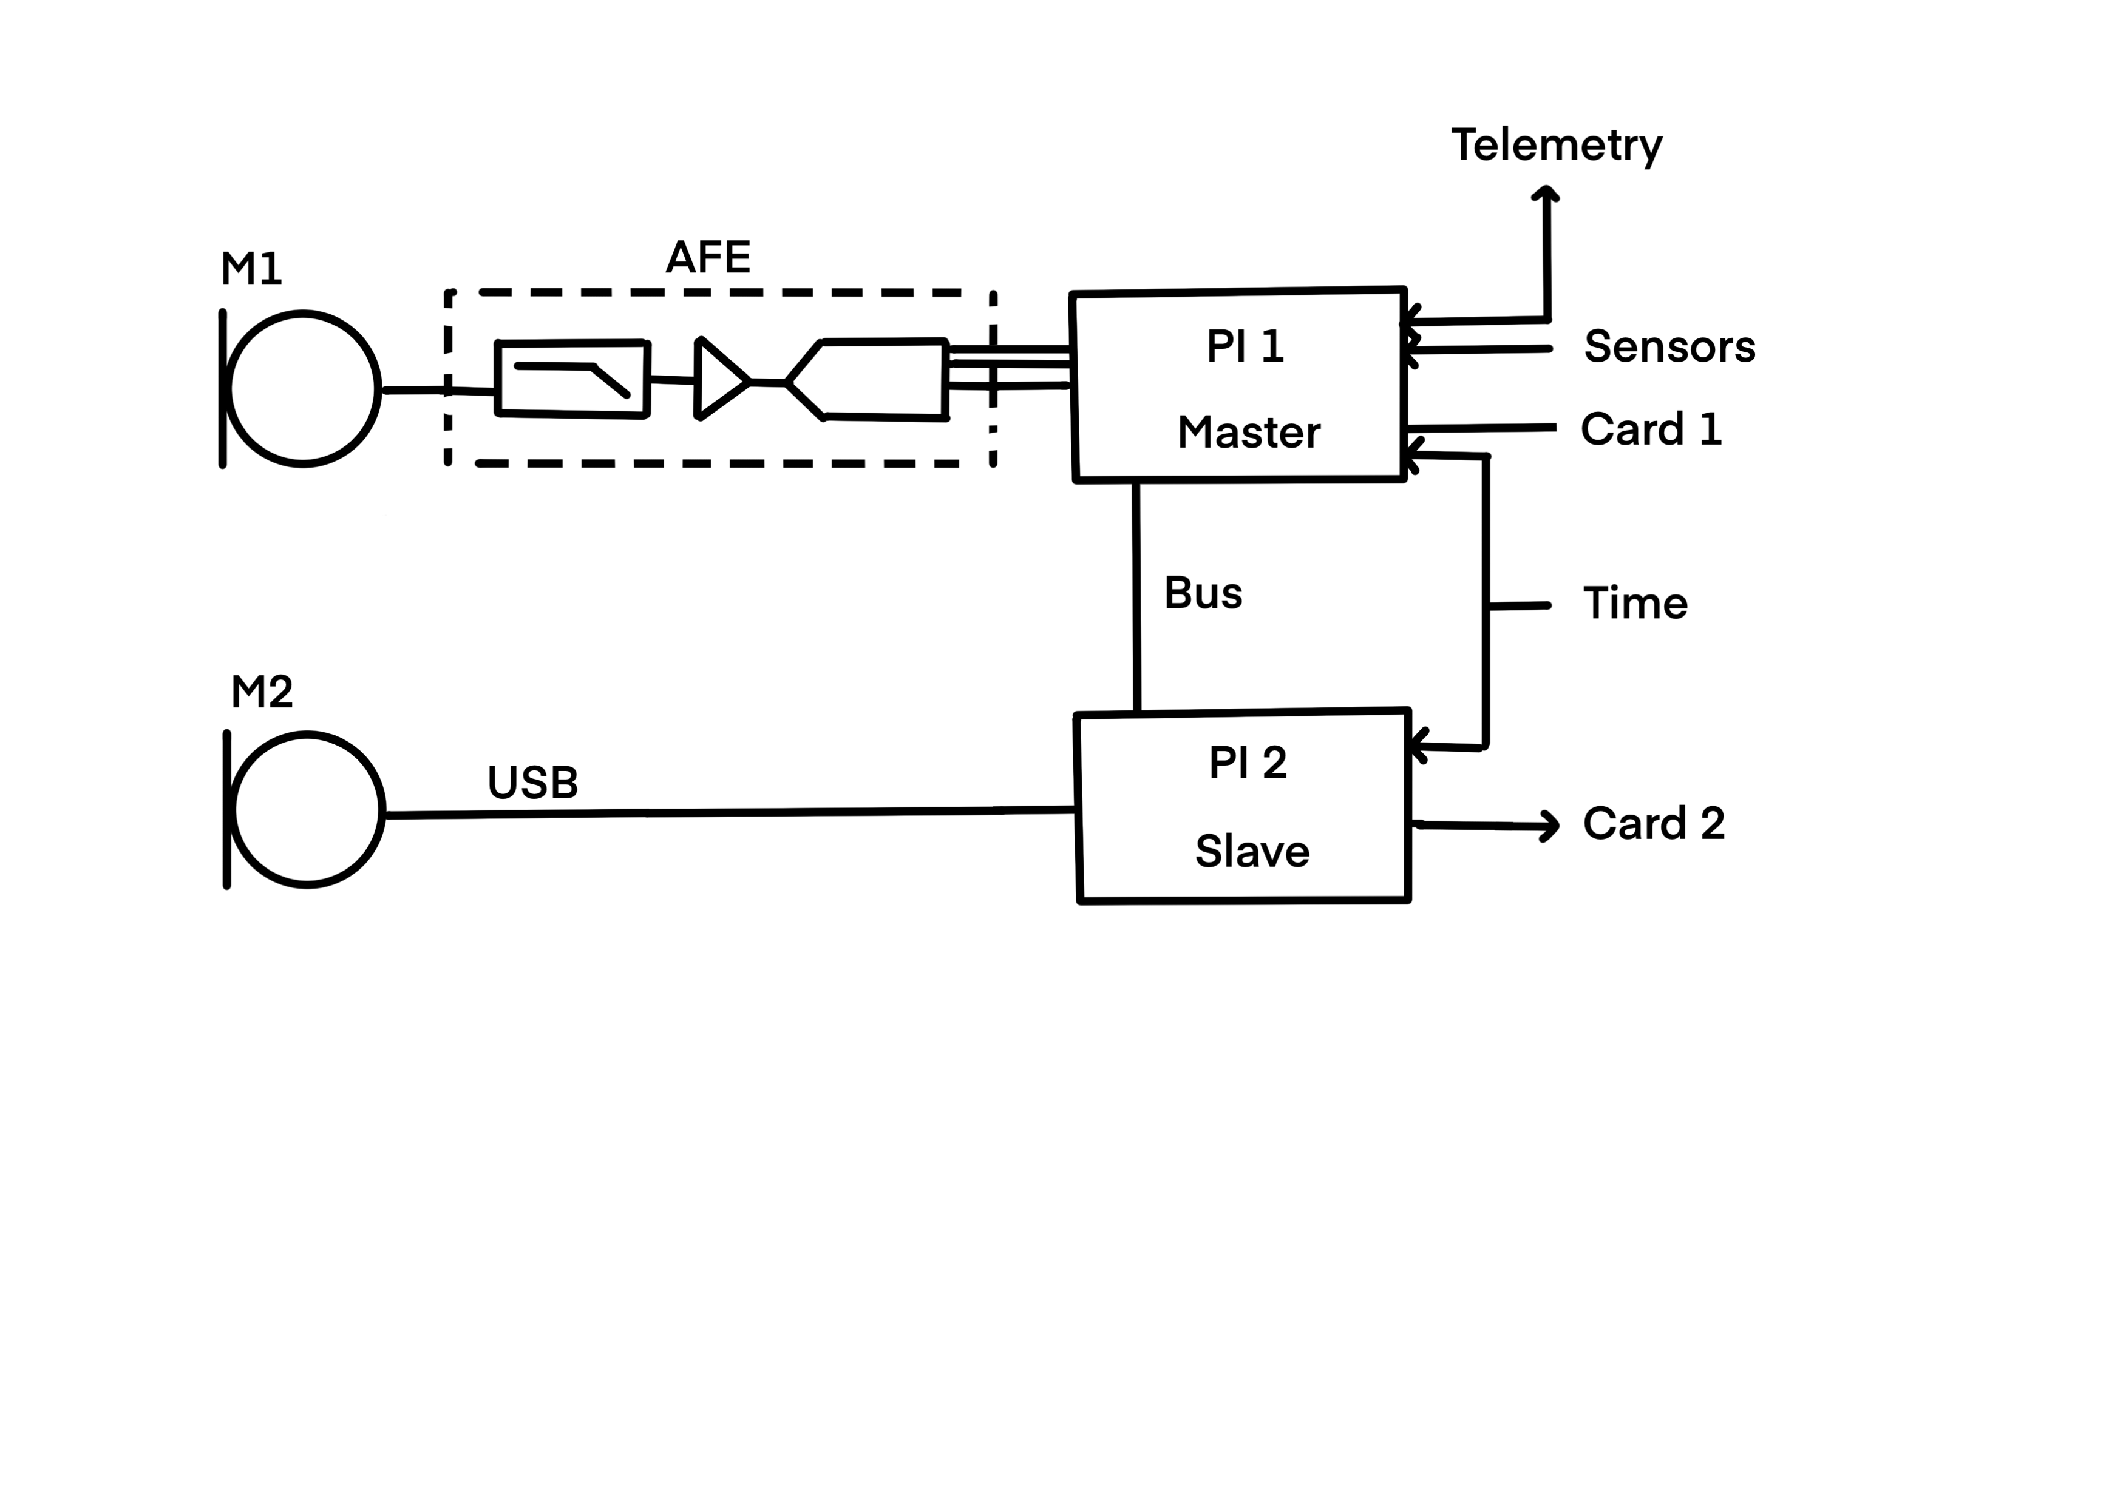
4.Technical requirements and project design 4.2 Measuring setup

Slide 15
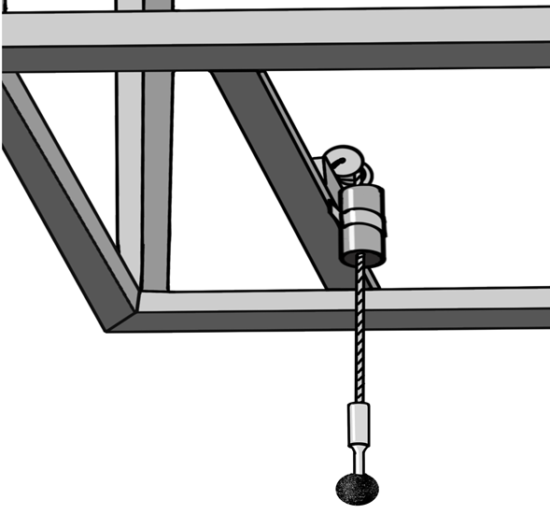
4.Technical requirements and project design 4.3 Gondola Placement

Slide 16
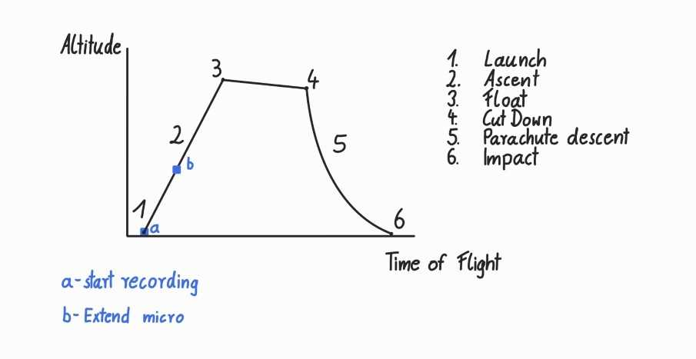
4.Technical requirements and project design 4.4 Flight timeline

